Slide 1

Training modules
Drought Proofing Tool

Slide 2
Drought proofing: 4 modules
Drought concepts
DeTypes
Measuring drought
Management interventions
Drought proofing framework
Water centric
Water budgeting
Managing supply and demand
Scenarios creation
Drought proofing tool
Concepts
Demonstration
Input data, scenarios and results
Drought proofing tool: Example case study
Running tool and interpreting data

Slide 3
Drought concepts

Slide 4
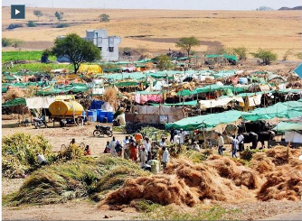
Drought: A Serious Water Related Risk
Monsoon dependent Indian agriculture suffers from recurring droughts
Droughts and floods are the two extremes of hydrology
Occurs in all agro-climatic regions, but has more severe impacts in arid and semi-arid regions and rainfed areas
A creeping type disaster that accumulates slowly and severely impacts agriculture, economy and society
Drought affects are more pronounced and long lasting
Increasing incidence and severity of droughts due to climate change
Flood frequented areas now witnessing drought and vice-versa

Slide 5
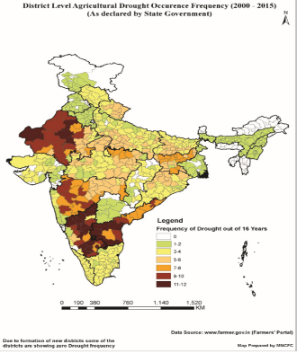
Increased Incidence & Severity of Droughts
Rainfall departure from normal-India
Dry reservoir/tank beds
Year | RF Deficit (Production loss) (%)
2002 | -19 (-15.40)
2009 | -23 (-4.12)
2014 | -12 (-3.25)
2015 | -14 (-2.35)
Dry wells
Increased frequency in last decade
% storage (MMI reservoirs) in 2009 compare to last 10 years average

Slide 6
Understanding the Drought types and impacts
Precipitation deficiency
High Temperature, Winds, Sunshine
Economic Impacts
Increase in food prices
Loss to dairy, livestock
Damage to fish habitat
Loss of hydro power
Meteorological
Drought
A significant deficiency in rainfall leads to drought
Soil water deficiency
Increased ET
Plant Water Stress
Agricultural drought
Social Impacts
Food deficit, suicides
Water user conflicts
Political conflicts
Increased poverty
Drying of water bodies
Reduced stream flow
Depleting groundwater
Hydrological drought
A normal, recurring climate phenomenon varying in space-time-intensity
Environ. Impacts
Desertification
Severity of fires
Damage to plants
Diseases
Reduced supply of economic goods due to weather variability/ water scarcity
Socioeconomic Drought

Slide 7
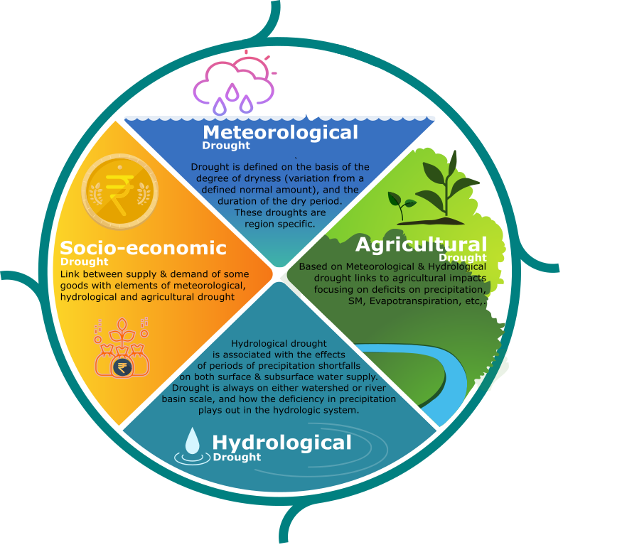

Drought types
Natural Climate Variability
Precipitation Deficiency
(amount, intensity, timing)
High temperature, high winds, low relative humidity, greater sunshine, less cloud cover
Meterological Drought
Reduced infiltration, runoff, deep percolation and ground water recharge
Increased evaporation and transpiration
Agricultural Drought
Soil Water Deficiency
Plant Water Stress, reduced biomass and yield
Hydrological Drought
Reduced streamflow, inflow to reservoirs, lakes and ponds; Reduced wetlands,
Wildlife habitat
Socio-Economic Drought
Economic Impacts
Social Impacts
(Source: NDMC)

Slide 8
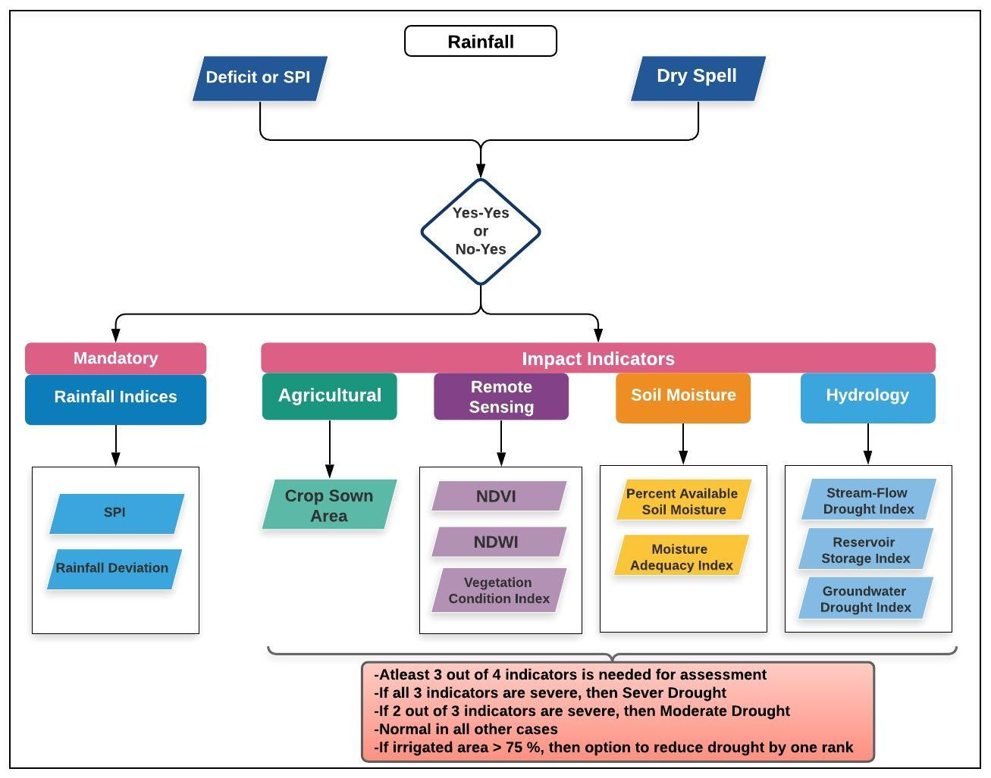
Drought assessment, indicators and declaration Manual for Drought Management, India (2016)
Indicators
Meteorological (rainfall)
Deficiency
Delay
Dry spells
Hydrological
Storage reservoir, tanks
Streamflow
Groundwater level
Agricultural
Sowing delay
Sown area
Crop health
Soil moisture
Cropping pattern

Slide 9
Managing Drought: Crisis Management to Risk Management
Traditional approach to drought management is reactive and addresses crisis management after drought takes place
It’s ad-hoc, often expensive and response is poorly coordinated and targeted
Increased realization to shift from crisis management to Risk Management through medium and long term drought proofing measures as a preparedness strategy
Pro-active measure with advance planning to improve operational capabilities (climate and water supply monitoring, building resilience and institutional capacity), preparedness and mitigation to reduce future impacts.
Drought Management Plans consisting of monitoring and early warning, long and medium term mitigation and response measures including supply augmentation and demand management to lessen the need for ad-hoc interventions.

Slide 10
Medium and Long Term Strategy
-Supply Augmentation Measures
Investments in water harvesting and water storages including watershed management
Networking of reservoirs, lakes, rivers, other water bodies,
Enhanced ground water recharge,
Ground water banking during non-drought years,
Improved water conveyance and piped distribution
Conjunctive use of rain, canal and ground water
Long Term: Demand management Measures
Efficient water application including micro irrigation
Economic incentives for water saving
Increasing water productivity
Water budget based crop and water use planning
Drought tolerant and water efficient cultivars
Crop diversification to minimize water use
Conservation agriculture, land levelling, mulching

Slide 11
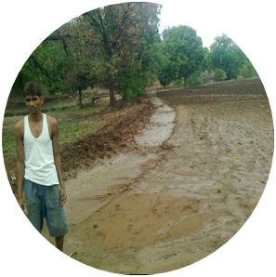
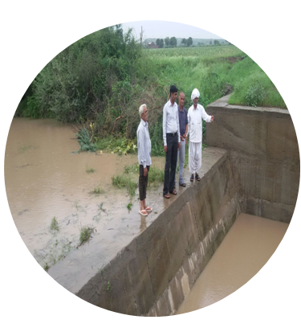
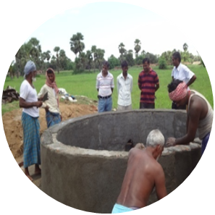
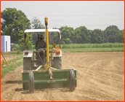
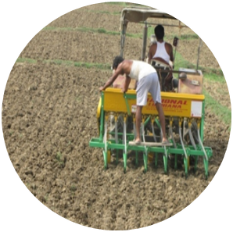
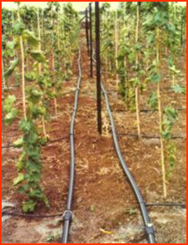
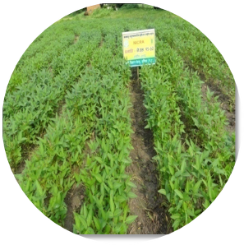
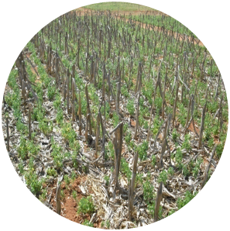
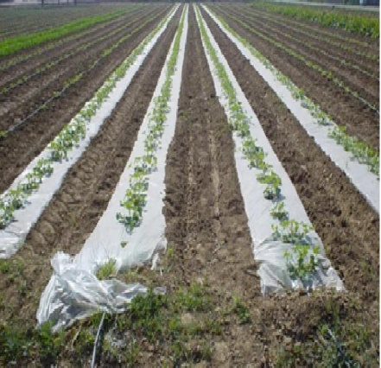
Smart Drought Management Interventions
Building resilience by enhancing storage (in situ, surface and groundwater)
Improving irrigation efficiency and water productivity
Laser land leveling, zero-tillage & conservation agriculture, BBF
Conjunctive use of good and poor quality GW / wastewater
Drought tolerant crop varieties
Crop diversification
Integrated farming systems
DSR
BBF
CA

Slide 12
Drought proofing framework

Slide 13
Drought proofing
Drought proofing an area then implies that the local natural and human production resource base:
Can provide a certain desirable amount of food, fuel, fodder, drinking water, and livelihood resources during a drought.
Fall in production can be minimized.
Drought proofing framework
Drought proofing is defined as preparing catchments to face drought with the minimum possible adverse effects by efficient and effective use of water resources with the objective of stabilizing crop production
Outcome of stabilizing crop production: enhanced farmers’ drought resilience at micro level and stabilizing farm incomes.
Drought proofing framework is developed for conceptualizing drought proofing and accordingly design the interventions to alleviate the crop from future droughts

Slide 14
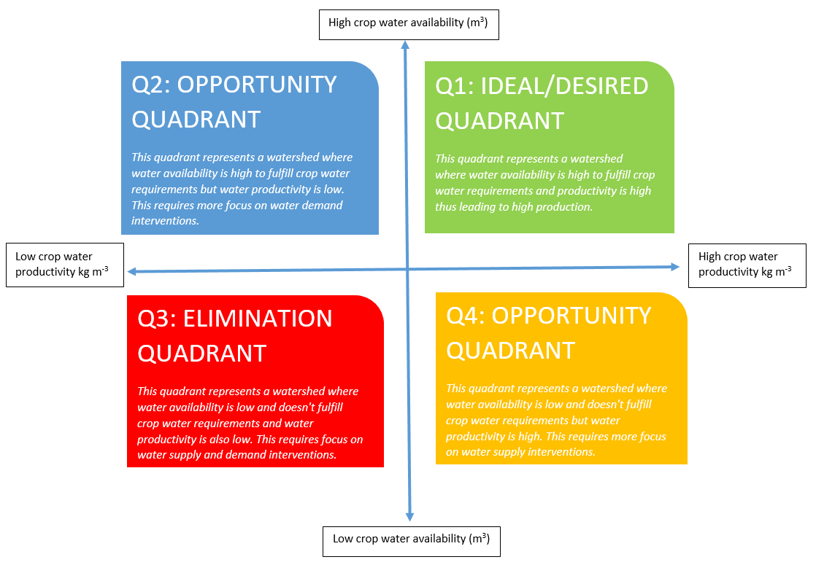
Drought proofing framework
4 quadrant approach
Conceptualize ‘drought proofing’ as an interaction between water availability for crop and water productivity/efficiency
Indicates where a crop lies and what interventions (and to what intensity) are required.
With intra and inter-year variability, need to ascertain this for different seasons and different years
e.g. in normal year, crop might lie in quadrant 1 but in drought year in quadrant 4 thus need for building water supply augmentation
High crop water availability
Efficiency/Demand management interventions
Low Water productivity/ efficiency
High Water productivity/ efficiency
Supply augmentation interventions
Low crop water availability

Slide 15
Example
High water availability
Good year but low water use efficiency
Desired situation: High WA and high water use efficiency
Improve Water Use Efficiency
Demand/efficiency improvement interventions required
Crop 1 in drought year after interventions
Low water use efficiency
High water use efficiency
Improve Water availability and Use Efficiency
Improve water availability
Both supply and demand/efficiency intervention required
Crop 1 in drought year
supply side intervention required
Drought: Low WA and low water use efficiency
Drought: Low WA and high water use efficiency
Low Water availability

Slide 16
Drought proofing indicators
Increase in Water availability
CROP WATER NEEDS ARE MET
Increase in yield and production
Increase in Water use efficiency
Increase in Water availability through rainfall capture in soil moisture, ponds/surface storages and GW recharge (reduction in run-off) and reducing non-beneficial evaporation from fallow areas.
Increase in water application efficiency in irrigated agriculture
Assuming all other non-water management interventions are in place
Taking attainable yield: average yield in normal years with no deficit

Slide 17
Operationalizing Drought proofing framework

Slide 18
Assessing Drought Proofing: Methodology
Design principle: Scientifically robust but simple to be applied on field with minimum training
Drought risk assessment
Rainfall deficit: Frequency, Severity and Timing
Application
Apply to Agri-catchments
Suggest and assess interventions
Water balance tool

Slide 19
Drought Risk assessment
Drought is characterized by the intensity, duration and timing.
Drought index used to assess drought risk.
A drought index is a standardized numerical value based on anomalies of a selected parameter (e.g. precipitation, soil moisture) when compared with its long-term mean
Part of drought manual
Standard Precipitation Index (SPI): Widely used rainfall index
Assigns a single numeric value to precipitation -> can be compared across regions and time scales.
Only rainfall data is needed and easy to calculate
Drought initiation and termination are implicit part of the index
Can be calculated for different time steps (1, 3, 6 and 12 months) with shorter time periods for agricultural and meteorological drought the longer seasons for hydrological drought
Drought intensity, magnitude, and duration can be determined, as well as the frequency of drought.

Slide 20
Standard Precipitation Index (SPI)
Values of SPI are expressed in standard deviations, positive SPI indicating greater than median precipitation and negative values indicating less than median precipitation.
Use of SPI
To know when and how frequently the drought occurs
Longer SPI (3 or 4 months): For entire crop duration
Shorter SPI ( 1 month): Intra season variation
Planning and designing interventions to mitigate seasonal and intra-seasonal drought
For each season and month, % of years under different drought categories are calculated.
SPI values | Drought category
0 to -0.99 | Mild drought
-1.00 to -1.49 | Moderate drought
-1.50 to -1.99 | Severe drought
< -2.0 | Extreme drought

Slide 21
SPI Example (Mysore)
Severity of droughts in different months and season (as % in last 40 years)
 | No drought | Mild | Moderate | Severe | Extreme
Overall [May-April] | 52.6% | 23.7% | 21.1% | 2.6% | 0.0%
May-Aug [Kharif] | 52.6% | 31.6% | 5.3% | 10.5% | 0.0%
May | 44.7% | 44.7% | 5.3% | 2.6% | 2.6%
June | 47.4% | 42.1% | 10.5% | 0.0% | 0.0%
July | 50.0% | 34.2% | 5.3% | 7.9% | 2.6%
Aug | 52.6% | 28.9% | 13.2% | 5.3% | 0.0%
Sep-Nov [Rabi] | 52.6% | 31.6% | 10.5% | 2.6% | 2.6%
Sep | 52.6% | 34.2% | 5.3% | 2.6% | 5.3%
Oct | 57.9% | 23.7% | 13.2% | 2.6% | 2.6%
Nov | 52.6% | 31.6% | 5.3% | 7.9% | 2.6%
Ragi
Tobacco
All seasons and monthly, 50 % are drought years (1 in 2 years). Most are mild droughts.
Kharif season:
Higher drought in July and August: Need for drought proofing measures
Rabi season:
Highest frequency in November with higher risk of sever drouhts
September highest risk of extreme droughts
Need for water supply augmentation for low rainfall months in rainfall season

Slide 22
Drought proofing-Water Balance tool

Slide 23
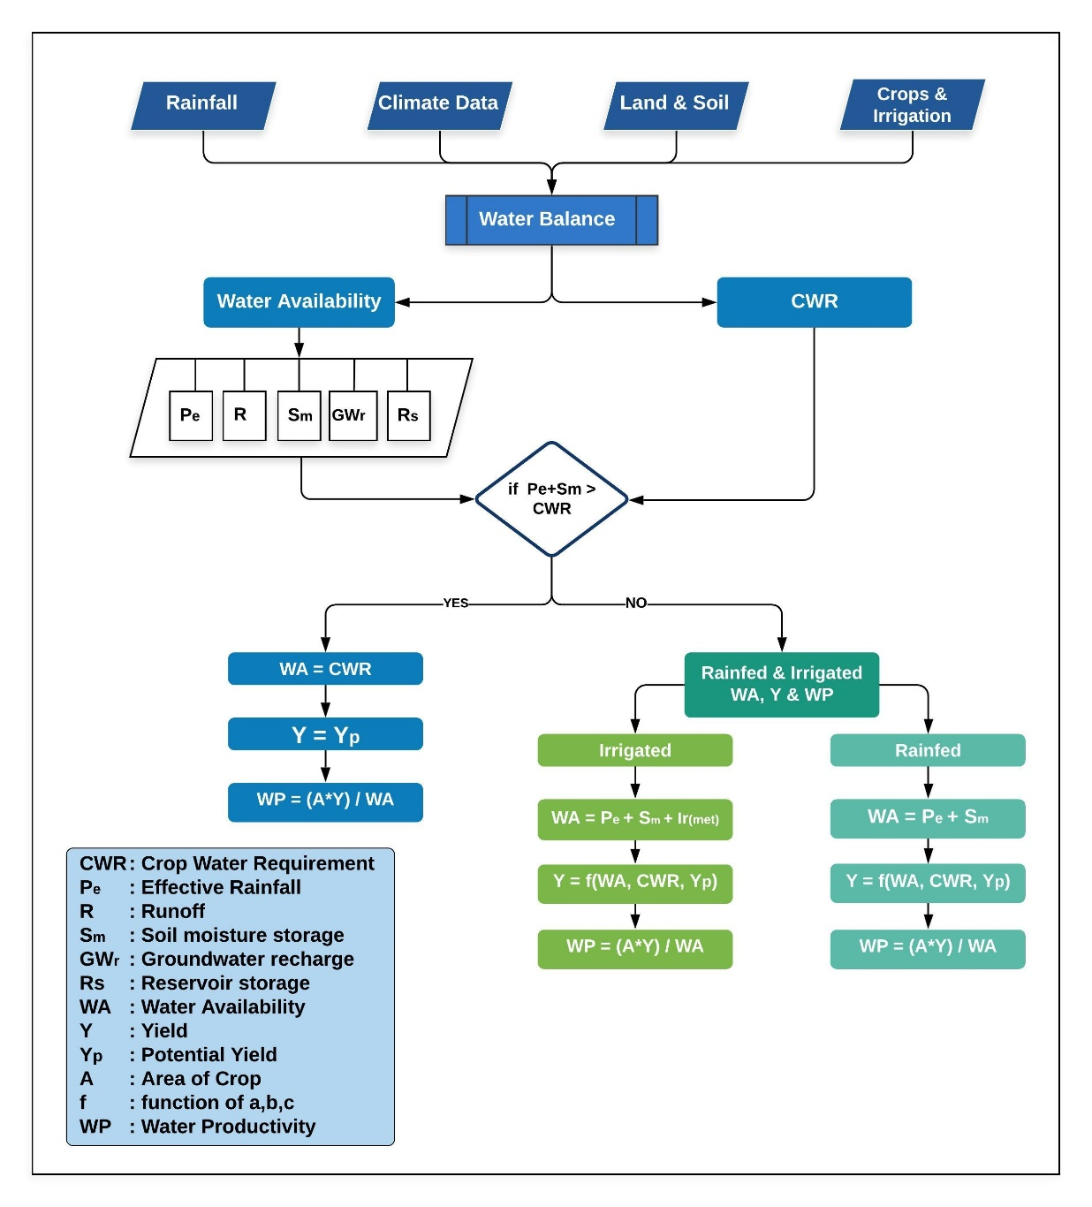
Tool
To help in watershed water balance, crop yield and crop requirement assessments
Dynamically links water balance with water management interventions and assess impact of drought on crop production
Plan and simulates how much interventions can mitigate the negative impacts
Applies monthly water budget approach in balancing the water resources availability and water demand
Modelled in excel spread sheet with minimum input data requirements for simplifications.

Slide 24
Key points
The two-key function of the tool are
To assess the water balance of the study area for various hydrological conditions (dry, normal & wet year)
To assess the impact of proposed land and water interventions
Suitable for homogenous agri-catchments with crop area as dominant land use
Modelled in excel spread sheet with minimum input data requirements for simplifications.
Inbuilt default datasets, minimum data requirements
Easy to use, no software requirements (other than excel)
Simple and robust methodology

Slide 25
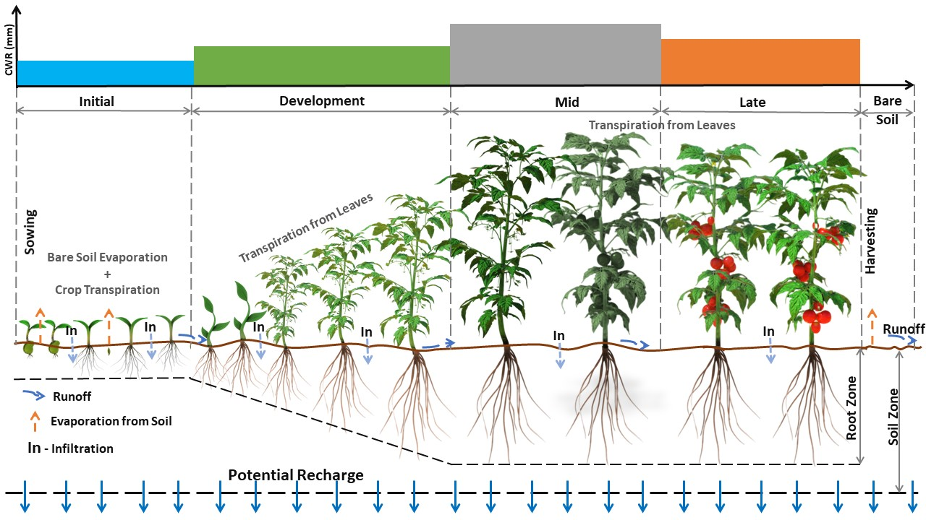
Robust Methodology (Backend)
Runoff
USDA SCS- curve number based
Daily soil moisture balance
Fallow and crop
Root growth
Soil moisture stress
FAO-56 methodology
15+ crops
Data inbuilt
GW processes
Simple, single bucket
No baseflow
All soil moisture excess is considered recharge

Slide 26
Inbuilt Water management interventions
Three categories:
Supply
Demand
Soil and Moisture
Increase water availability in surface and groundwater for irrigation
Increase irrigation water application efficiency
Increase soil moisture,
reduce runoff and increase recharge

Slide 27

Water Management Interventions
Supply Side
Interventions
Demand Side
Interventions
Soil Moisture
Interventions
Farm Pond
Farm Pond (Lined)
Infiltration Ponds
Injection/Borewell
Check dams / Gully Plugs
Drip Irrigation*
Sprinkler*
Land Levelling
Ridge & Furrow Irrigation*
Deficit Irrigation*
Direct Seeded Rice (DSR)*
Alternate Wetting & Drying (AWD)*
System of Rice Intensification (SRI)*
Cover Crops*
Mulching*
Conservation Tillage
Bunds (Field / Contour Bunds)
Broad bed Furrows*
* Crop Specific
Increase water availability in surface and groundwater for irrigation
Increase irrigation water application efficiency
Increase soil moisture and Reduce runoff and increase recharge

Slide 28
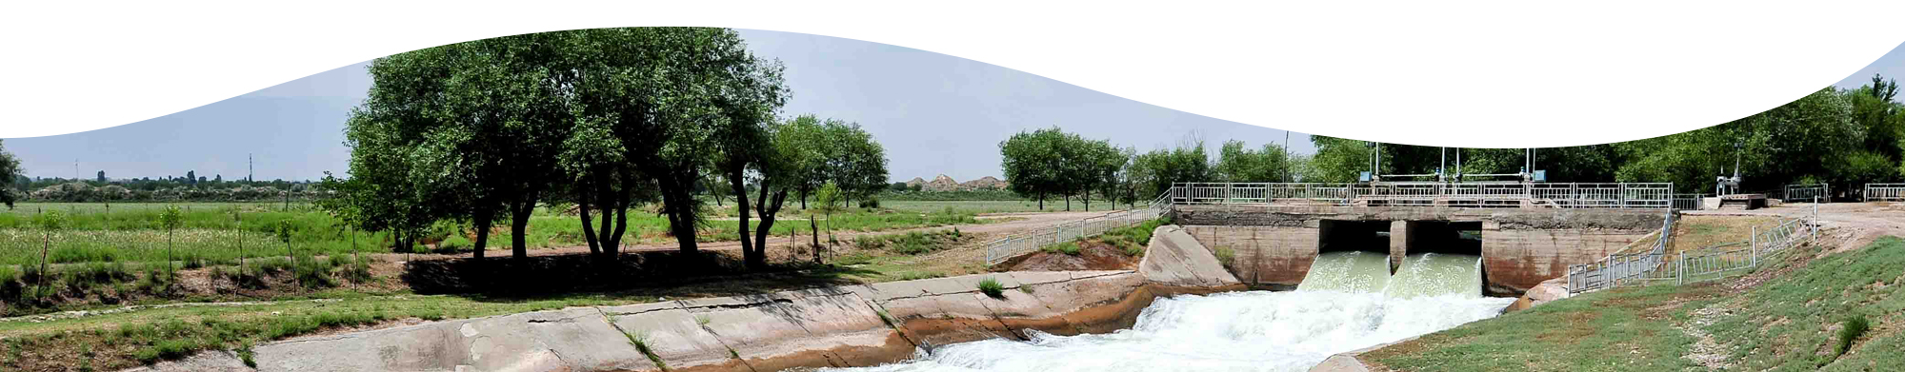
Interventions: Supply
Intervention | Impact on physical process or parameters | How it works in the tool | User Inputs
Farm pond | Increases Storage (+ SR) Increases Recharge (+ GWR) | Farm pond, Farm Pond(lined) and check dam captures runoff based on overall storage value and current storage. Infiltration rate is averaged and is taken out monthly from storage and added to ground water recharge. Recharged water is made available for extraction | - Volume (m³) - Average Depth (m) - Infiltration Rate (mm/day) - Cost (Rs/m³)
Farm pond (Lined) | Provide storage (+ SR) Reduces seepage & infiltration |  | - Volume (m³) - Average Depth (m) - Cost (Rs/m³)
Check dam / Gully Plug | Increases Storage (+ SR) Increases Recharge (+ GWR) |  | - Volume (m³) - Average Depth (m) - Infiltration Rate (mm/day) - Cost (Rs/m³)
Infiltration Ponds | Increases Recharge (+ GWR) | Runoff captured (Volume (m³)) in ponds is added to Ground water recharge through Infiltration. Recharged water is made available for extraction | - Volume (m³) - Average Depth (m) - Infiltration Rate (mm/day) - Cost (Rs/m³)
Injection / Borewells | Increases Recharge (+ GWR) | Recharges runoff directly. Recharged water is made available for extraction | - Total numbers - Volume (m³) - Infiltration Rate (mm/day) - Cost (Rs/nos)

Slide 29


Interventions: Demand
Intervention | Impact on physical process or parameters | How it works in the tool | User Inputs
Drip Irrigation [Crop Specific] | Increases Water Use Efficiency$(+ η)$ | Crop Water needs is reduced due to increased water use efficiency Default Efficiency $(η)$ of 90% | - Crop wise Area covered (ha) - Efficiency $(η$) (Optional) - Cost (Rs/ha)
Sprinkler [Crop Specific] | Increases Water Use Efficiency$(+ η)$ | Crop Water needs is reduced due to increased water use efficiency Default Efficiency $(η)$ of 75% | - Crop wise Area covered (ha) - Efficiency $(η$) (Optional) - Cost (Rs/ha)
Land Levelling [All Crops] | Water saved (%) | Water Saved due to intervention is converted to Water use efficiency Crop Water needs is reduced due to increased water use efficiency | - Crop wise Area covered (ha) - Water Saved (%) (Optional) - Cost (Rs/ha)
Direct Seeded Rice (DSR) [Crop Specific] | Water saved (%) |  | - Crop wise Area covered (ha) - Water Saved (%) (Optional) - Cost (Rs/ha)
cont..

Slide 30
Interventions: Demand
Intervention | Impact on physical process or parameters | How it works in the tool | User Inputs
Alternate Wetting & Drying (AWD) [Crop Specific] | Water saved (%) | Water Saved due to intervention is converted to Water use efficiency Crop Water needs is reduced due to increased water use efficiency | - Crop wise Area covered (ha) - Water Saved (%) (Optional) - Cost (Rs/ha)
System of Rice Intensification (SRI) [Crop Specific] | Water saved (%) |  | - Crop wise Area covered (ha) - Water Saved (%) (Optional) - Cost (Rs/ha)
Ridge & Furrow Irrigation [Crop Specific] | Water saved (%) |  | - Crop wise Area covered (ha) - Water Saved (%) (Optional) - Cost (Rs/ha)
Deficit Irrigation [Crop Specific] | Water saved (%) |  | - Crop wise Area covered (ha) - Water Saved (%) (Optional) - Cost (Rs/ha)
cont..

Slide 31

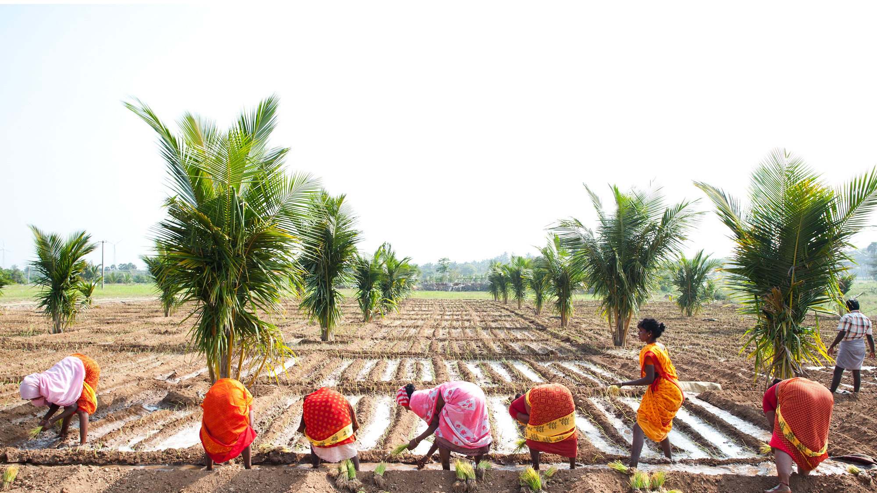
Interventions: Soil Moisture
Intervention | Impact on physical process or parameters | How it works in the tool | User Inputs
Cover Crops [Crop Specific] | Increases Soil moisture retention capacity & Reduces Evaporation Reduces Runoff (CN Reduction) | Runoff reduced due to CN reduction Reduces Soil evaporation by 50% during initial stage 1 crop growth | - Crop wise Area covered (ha) - CN reduction (Optional) - Cost (Rs/ha)
Mulching [Crop Specific] | Increases Soil moisture retention capacity & Reduces Evaporation Reduces Runoff (CN Reduction) |  | - Crop wise Area covered (ha) - CN reduction (Optional) - Cost (Rs/ha)
Conservation Tillage [All Crops] | Increases Soil moisture retention capacity & Reduces Evaporation Reduces Runoff (CN Reduction) |  | - Crop wise Area covered (ha) - CN reduction (Optional) - Cost (Rs/ha)
Bunds (Field/Contour bunds) [All Crops] | Reduces Runoff (CN Reduction) | Runoff reduced due to CN reduction Default CN Reduction - 3 | - Crop wise Area covered (ha) - CN reduction (Optional) - Cost (Rs/ha)
Broad Bed Furrows [Crop Specific] | Reduces Runoff (CN Reduction) | Runoff reduced due to CN reduction Default CN Reduction - 3 | - Crop wise Area covered (ha) - CN reduction (Optional) - Cost (Rs/ha)

Slide 32
Default large inbuilt database
Curve number, radiation
Matrix of land use, soil, solar radiation
Soils
Infiltration rate, Field capacity, Wilting point
Crops
Crop growth duration, Crop coefficient, yield response factor, root depth, crop yield, price, depletion factor, return flows
Interventions
Impact of water balance components, costs..
Basic users: work with default data, Advance users: Can edit all data

Slide 33
Input data and interface

Slide 34
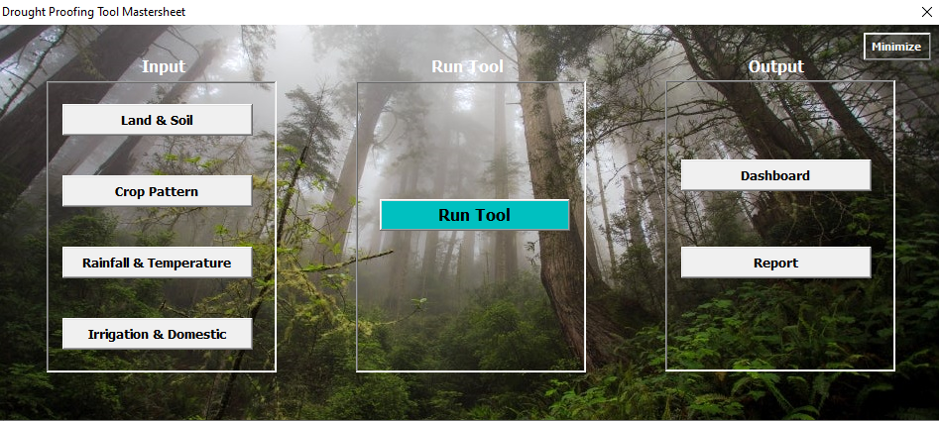

Slide 35

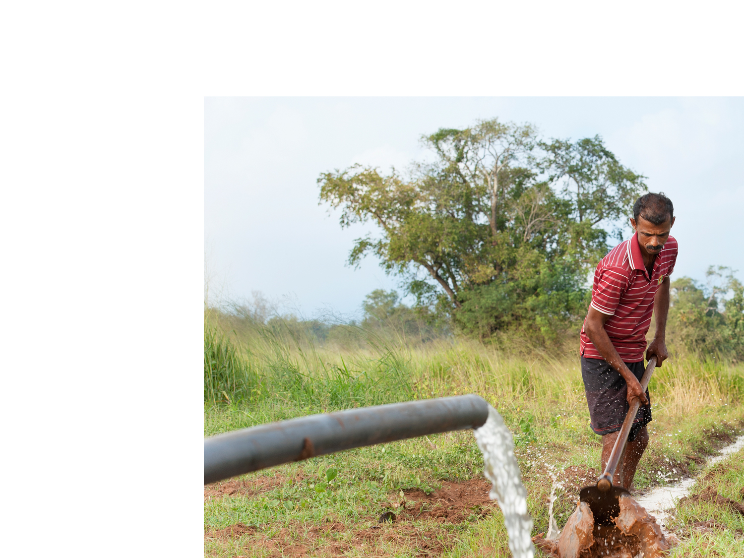







Easily acquired input Parameters
Land Use & Soil
Soil Types, depth & Distribution
Hydrological condition
Land Use Land Cover Data
Latitude & Hemisphere
Rainfall & Temperature
Daily Rainfall data
Monthly Min & Max temperature
SPI categories
Crop Pattern
Crop Type and growth duration
Upto 9 crops
Rainfed & Irrigated area
Sowing Month & Week
Irrigation & Domestic
Irrigation Efficiency
Groundwater & Surface water dependency (%)
River / Canal water availability
Population & daily water usage

Slide 36
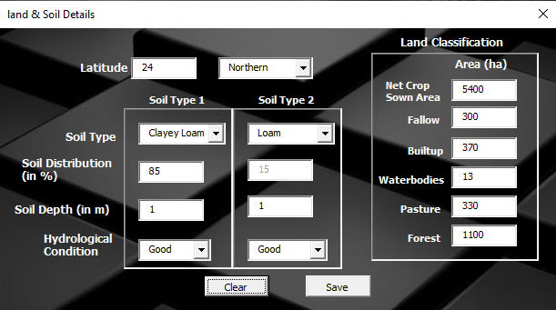
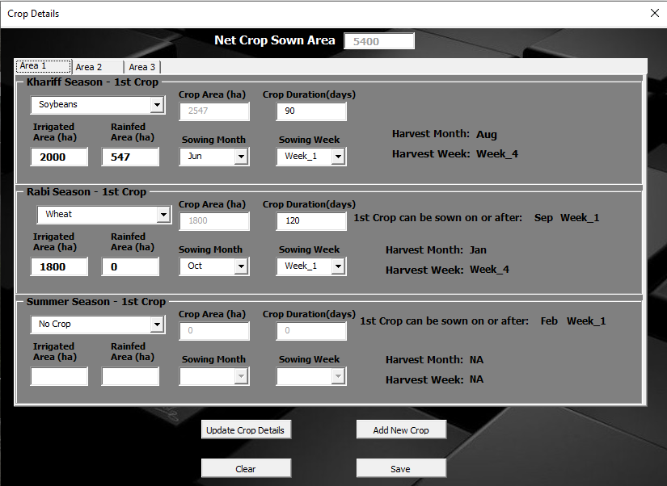
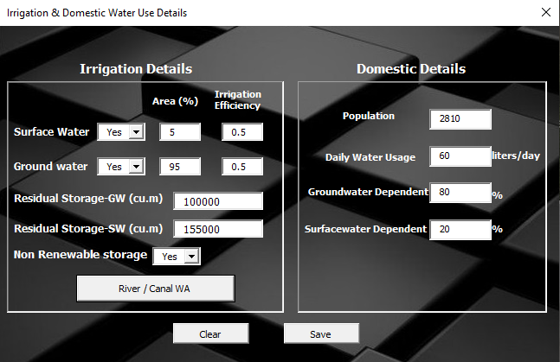

Slide 37


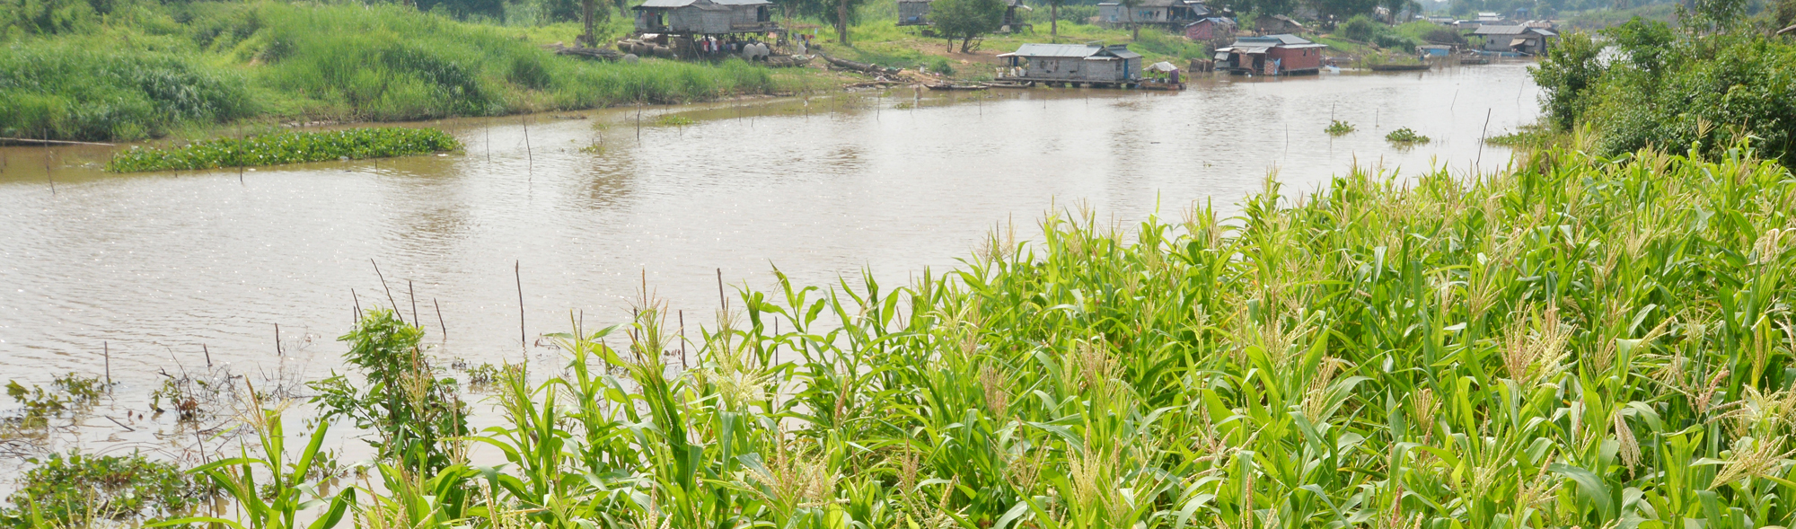

Defining Scenarios & Interventions
Supply Side Interventions
To Augment Water Storage
Increase Groundwater Storage
Interventions
Demand Side Interventions
Increase irrigation efficiency
Save Water
Economics
Evaluation Period
Interest rate
Scenarios
Simulating Water Balance for :-
For 20 years divided into different drought intensity based on SPI
Soil Moisture Interventions
Reduce Runoff & Soil Evaporation
Increase moisture holding capacity of Soil

Slide 38
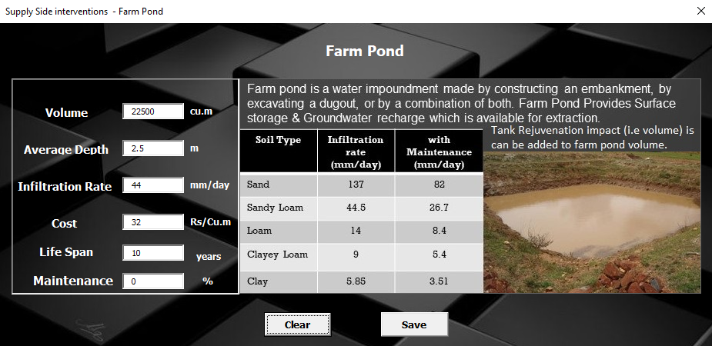
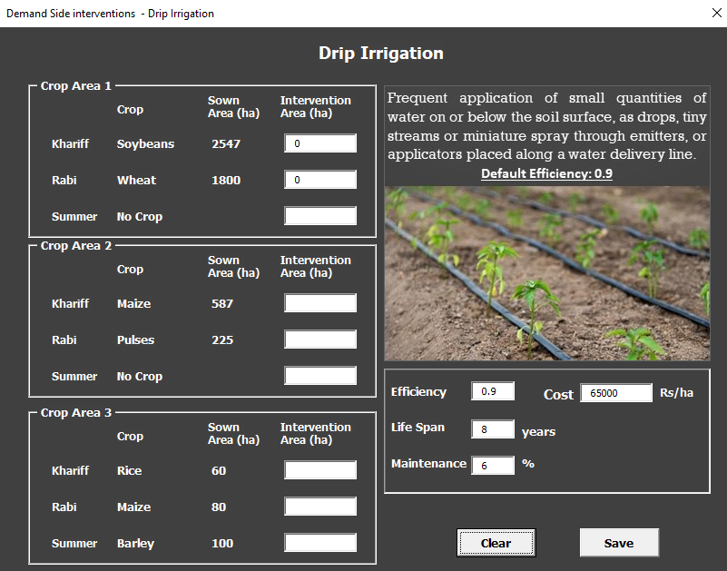
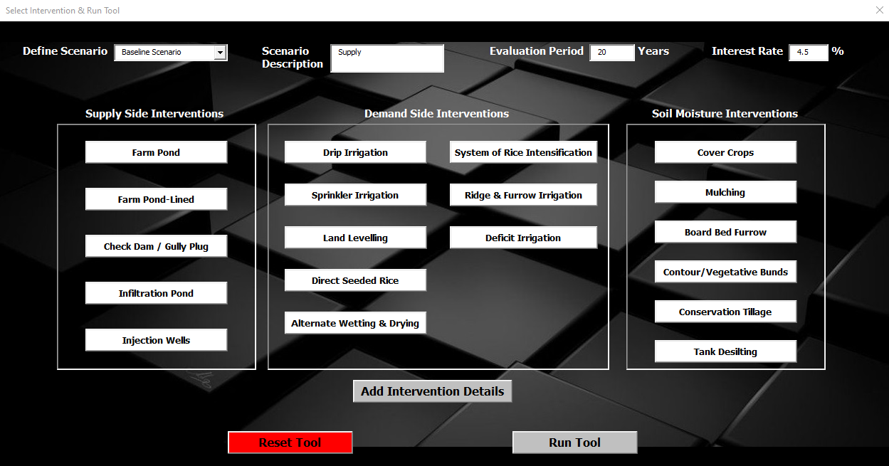
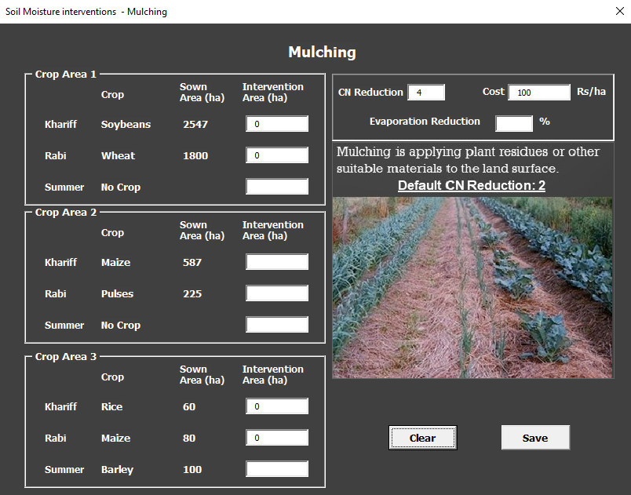

Slide 39
Intuitive Results: Direct use in DPR and planning
Crops
Crop water requirements
Irrigation water requirements
Yield
Rainfed and irrigated
Water balance
Recharge
Runoff
ET
Annual and monthly
Drought proofing quadrant
Quadrant
Aggregated results
Economy
Costs and benefits

Slide 40
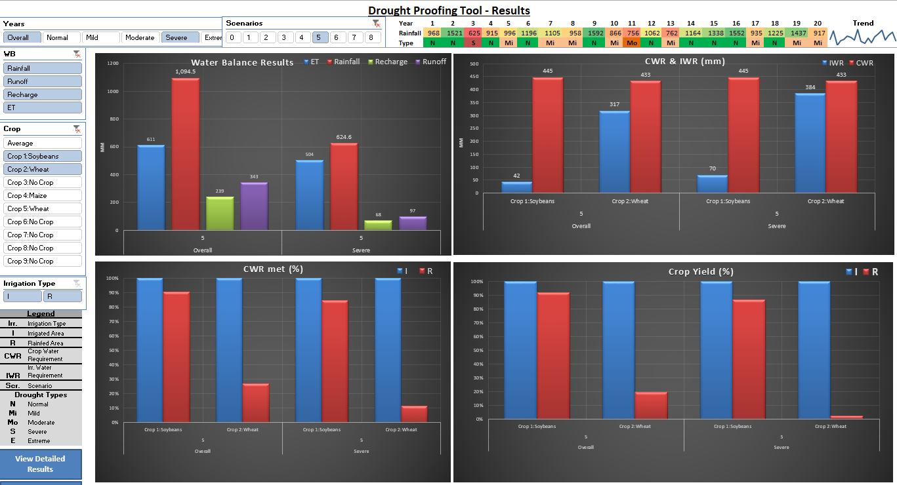
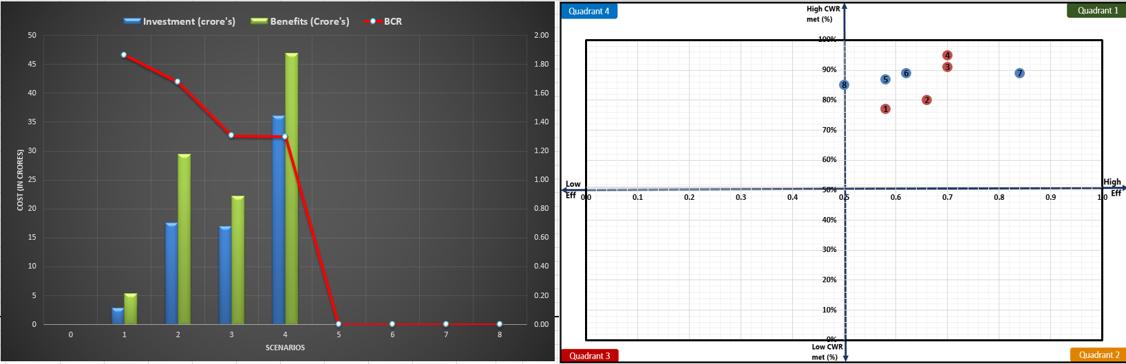

Slide 41
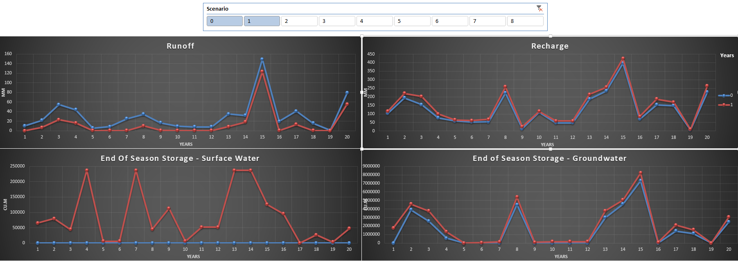
Advance: Calibration and Validation

Slide 42
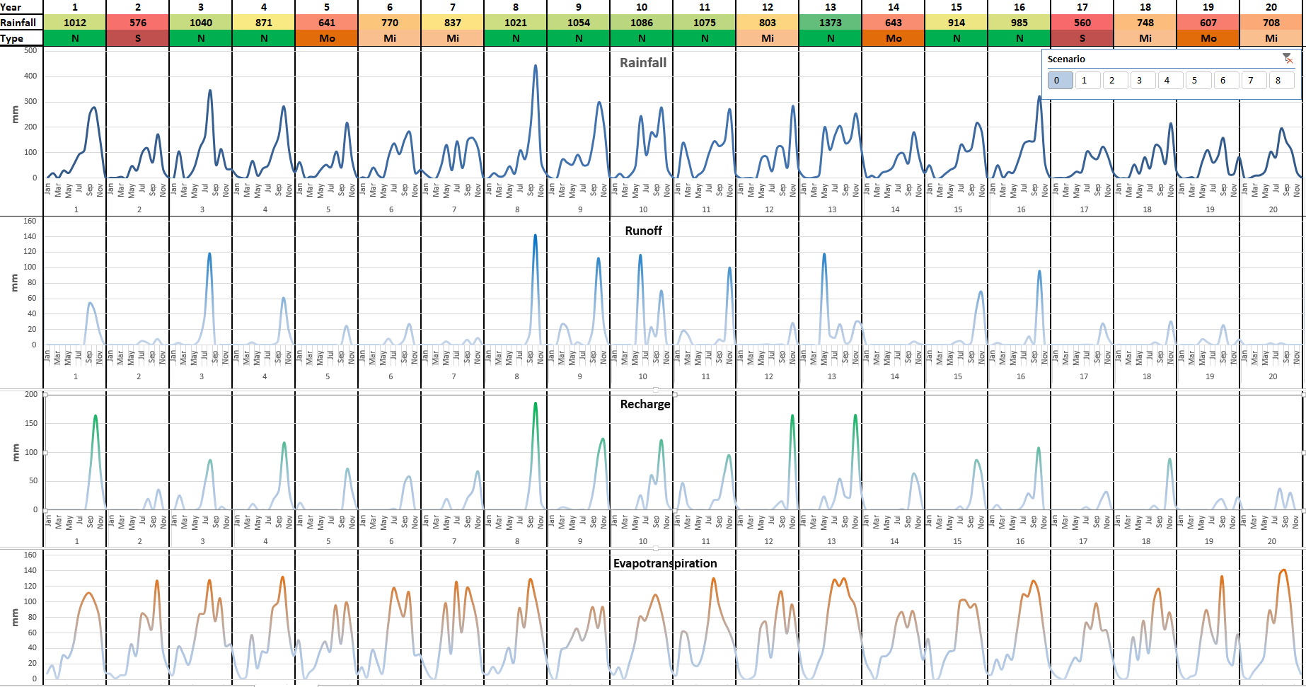

Slide 43
Further information
Tool user Manual: How to input data and run the tool
Tool technical Manual: Understand processes and methodologies
Link to documents and databases

Slide 44
DP tool example case study

Slide 45
Training 5 Steps
Acquire data
Data template
Go through data
Input data
Define scenarios
Understand results
Refine scenarios

Slide 46
Thank you!

